Slide 1
Part 1:
Java as an Object-oriented Programming Language
Java IO Stream

Slide 2
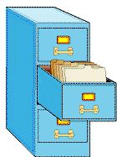
Files

Slide 3
Storage
  Modern computers have many different kinds of storage components:
  - memory (aka RAM or DRAM)
  - disks (aka “hard disks” or “hard drives”)
  - caches
  - external media (USB sticks, DVD, CD-RW, etc.)
  Why so many?
  Because they behave differently!

Slide 4
Memory vs. Disk
  Tradeoff:
  Disks have greater capacity (more GB) and offer permanent storage;
  Memory is much faster.
Typical Properties | Memory | Disk
Capacity: | 1-4 Gb | >100 Gb
When power goes off: | Data is lost | Data is safe
When program ends: | Data is lost | Data is safe
Sequential access speed: | 1.2 GB / second | 50 MB / second
Random access speed: | 1.2 GB / second | ?? ~ 66.7 seeks / second

Slide 5
Files and Directories
Your operating system (Windows, Mac, Linux, etc.) divides your disk hierarchically
This creates a tree structure
  Each element in the tree is a folder or directory
  Inside directories are files
tmp
Hello.java
super3
C:
Documents and Settings
All Users
Program Files
Adobe
…
WinShell

Slide 6
Files and Variables
Recall variables:
  They have types, names, and a location in memory
  You can put data inside them, and use the data later
Files are similar abstractions, but for the disk:
  They have names and a location on the disk
  You can put (lots of) data inside them
  You can later retrieve that data and use it

Slide 7
Two main file operations
Read
  Move data from a file on the disk into a variable (or variables) in memory
Write
  Move data from a variable (or variables) in memory to a file on the disk
Two tricky details to these operations –
  Data types
  Checked Exceptions

Slide 8
File class
The File class is a template for objects (in memory) that represent actual files (on disk):
File myFile = new File(“C:\myfile.txt”);
The File class is in the java.io package. To use it, include the import declaration:
  import java.io.*;
io (or I/O) stands for input/output.

Slide 9
Reading data from text files
Creating a Scanner for a file, general syntax:
  Scanner <name> = new Scanner(new File("<file name>"));
Example:
  Scanner input = new Scanner(new File("numbers.txt"));
Instead of getting data from the keyboard via System.in, this Scanner object gets data from the file numbers.txt in the current folder (directory).

Slide 10
Compiler error with files
The following program does not compile:
  1 import java.io.*; // for File
  2 import java.util.*; // for Scanner
  3
  4 public class ReadFile {
  5 public static void main(String[] args) {
  6 Scanner input = new Scanner(new File("data.txt"));
  7 // do something
  8 }
  9 }
The compiler reports:
  ReadFile.java:6: unreported exception java.io.FileNotFoundException; must be caught or declared to be thrown

Slide 11

Exceptions
exception: An object representing a program error.
  Programs with invalid logic will cause ("throw") exceptions.
Examples:
  Trying to read a file that does not exist.
  Dividing by 0.
  Using charAt(10) on a string of length 5.

Slide 12
Checked exceptions
checked exception: An exception that must be explicitly handled (otherwise the program will not compile).
  We must either:
    handle ("catch") the exception, or
    explicitly state that we choose not to handle the exception (and accept that the program will crash if the exception occurs)‏

Slide 13
throws clause: How to waive your rights
throws clause: Tells the compiler that a method may throw an exception.
  Like a waiver of liability:
  "I hereby agree that this method might throw an exception, and I accept the consequences (crashing) if this happens."
throws clause, general syntax:
public static <type> <name>(<params>) throws <type> {
Example:
  public static void main(String[] args)‏
  throws FileNotFoundException {

Slide 14
Patched code
import java.io.*; // for File, FileNotFoundException
import java.util.*; // for Scanner
public class ReadFile {
public static void main(String[] args)‏
throws FileNotFoundException {
Scanner input = new Scanner(new File("data.txt"));
// do something
}
}

Slide 15
Recap: Tokens
The Scanner breaks apart the input into tokens. It will interpret the tokens in different ways depending on if you call next(), nextInt(), or nextDouble().
Assuming the following input file:
  23 3.14
  "John Smith"
  The tokens in the input can be interpreted as the given types:
  Token Type(s)‏
  1. 23 int, double, String
  2. 3.14 double, String
  3. "John String
  4. Smith" String

Slide 16
The input cursor
Consider a file that contains this text:
  308.2
  14.9 7.4 2.8
  3.9 4.7 -15.4
  2.8
A Scanner views all input as a stream of characters, which it processes with its input cursor:
  308.2\n 14.9 7.4 2.8\n\n\n3.9 4.7 -15.4\n2.8\n
  ^

Slide 17
Consuming tokens
Each call to next, nextInt, nextDouble, etc. advances the cursor to the end of the current token, skipping over any whitespace. Each call consumes the input.
  input.nextDouble();
308.2\n 14.9 7.4 2.8\n\n\n3.9 4.7 -15.4\n2.8\n
^
  input.nextDouble();
308.2\n 14.9 7.4 2.8\n\n\n3.9 4.7 -15.4\n2.8\n
^

Slide 18
Exercise: Version 1
Consider an input file named input.txt:
  308.2
  14.9 7.4 2.8
  3.9 4.7 -15.4
  2.8
Write a program that reads the first 5 values from this file and prints them along with their sum.
Output:
  number = 308.2
  number = 14.9
  number = 7.4
  number = 2.8
  number = 3.9
  Sum = 337.19999999999993

Slide 19
Solution: Version 1
// Displays the first 5 numbers in the given file,
// and displays their sum at the end.
import java.io.*; // for File, FileNotFoundException
import java.util.*; // for Scanner
public class Echo {
public static void main(String[] args)‏
throws FileNotFoundException {
Scanner input = new Scanner(new File("numbers.dat"));
double sum = 0.0;
for (int i = 1; i <= 5; i++) {
double next = input.nextDouble();
System.out.println("number = " + next);
sum += next;
}
System.out.println("Sum = " + sum);
}
}

Slide 20
Reading a whole file
The preceding program is assumes you know how many values you want to read.
How could we read in ALL of the numbers in the file, without knowing beforehand how many the file contains?

Slide 21
Look before you read
The Scanner has useful methods for testing to see what the next input token will be.
Method Name
Description
hasNext()‏
whether any more tokens remain
hasNextDouble()‏
whether the next token can be interpreted as type double
hasNextInt()‏
whether the next token can be interpreted as type int
hasNextLine()‏
whether any more lines remain

Slide 22
Exercise: Version 2
Rewrite the previous program so that it reads the entire file.
Output:
  number = 308.2
  number = 14.9
  number = 7.4
  number = 2.8
  number = 3.9
  number = 4.7
  number = -15.4
  number = 2.8
  Sum = 329.29999999999995

Slide 23
Solution: Version 2
// Displays each number in the given file,
// and displays their sum at the end.
import java.io.*; // for File, FileNotFoundException
import java.util.*; // for Scanner
public class Echo2 {
public static void main(String[] args)‏
throws FileNotFoundException {
Scanner input = new Scanner(new File("numbers.dat"));
double sum = 0.0;
while (input.hasNextDouble()) {
double next = input.nextDouble();
System.out.println("number = " + next);
sum += next;
}
System.out.println("Sum = " + sum);
}
}

Slide 24
Exercise: Version 3
Modify the preceding program again so that it will handle files that contain non-numeric tokens.
  The program should skip any such tokens.
For example, the program should produce the same output as before when given this input file:
  308.2 hello
  14.9 7.4 bad stuff 2.8
  3.9 4.7 oops -15.4
  :-) 2.8 @#*($&

Slide 25
Solution: Version 3
// Displays each number in the given file,
// and displays their sum at the end.
import java.io.*; // for File, FileNotFoundException
import java.util.*; // for Scanner
public class Echo3 {
public static void main(String[] args)‏
throws FileNotFoundException {
Scanner input = new Scanner(new File("numbers.dat"));
double sum = 0.0;
while (input.hasNext()) {
if (input.hasNextDouble()) {
double next = input.nextDouble();
System.out.println("number = " + next);
sum += next;
} else {
input.next(); // consume / throw away bad token
}
}
System.out.println("Sum = " + sum);
}
}

Slide 26
Line-based processing

Slide 27
Who's next in line?
Reading a file line-by-line, general syntax:
  Scanner input = new Scanner(new File("<file name>"));
  while (input.hasNextLine()) {
  String line = input.nextLine();
  <process this line>;
  }
The nextLine method returns the characters from the input cursor's current position to the nearest \n character.

Slide 28
Reading between the newlines
23 3.14 John Smith "Hello world"
45.2 19
23\t3.14 John Smith\t"Hello world"\n\t\t45.2 19\n
input.nextLine()‏
23\t3.14 John Smith\t"Hello world"\n\t\t45.2 19\n
^
input.nextLine()‏
23\t3.14 John Smith\t"Hello world"\n\t\t45.2 19\n
^
NB: The \n character is consumed but not returned.

Slide 29
Exercise
Write a program that reads a text file and "quotes" it by putting a > in front of each line.
Input:
  Hey Prof. Yates,
  I would like to know more about files. Please explain them to me.
  Sincerely,
  Susie Q. Student
Output:
  > Hey Prof. Yates,
  > I would like to know more about files. Please explain them to me.
  > Sincerely,
  > Susie Q. Student

Slide 30
Solution
import java.io.*;
import java.util.*;
public class QuoteMessage {
public static void main(String[] args)‏
throws FileNotFoundException {
Scanner input = new Scanner(new File("message.txt"));
while (input.hasNextLine()) {
String line = input.nextLine();
System.out.println(">" + line);
}
}
}

Slide 31
Example
Example file contents:
  123 Susan 12.5 8.1 7.6 3.2
  456 Brad 4.0 11.6 6.5 2.7 12
  789 Jennifer 8.0 8.0 8.0 8.0 7.5
Consider the task of computing the total hours worked for each person represented in the above file.
  Susan (ID#123) worked 31.4 hours (7.85 hours/day)‏
  Brad (ID#456) worked 36.8 hours (7.36 hours/day)‏
  Jennifer (ID#789) worked 39.5 hours (7.9 hours/day)‏

Slide 32
Line-based or token-based?
Neither line-based nor token-based processing works.
The better solution is a hybrid approach
  Break the input into lines.
  Break each line into tokens.

Slide 33
Scanners on Strings
A Scanner can be constructed to tokenize a particular String (such as one line of an input file).
  Scanner <name> = new Scanner(<String>);
Example:
  String text = "1.4 3.2 hello 9 27.5";
  Scanner scan = new Scanner(text); // five tokens

Slide 34
Tokenizing lines
Scanner input = new Scanner(new File("<file name>"));
while (input.hasNextLine()) {
String line = input.nextLine();
Scanner lineScan = new Scanner(line);
<process this line>;
}

Slide 35
Multi-line records
The following data represents students' course information.
  Erica Kane
  3 2.8 4 3.9 3 3.1
  Greenlee Smythe
  3 3.9 3 4.0 4 3.9
  Ryan Laveree, Jr.
  2 4.0 3 3.6 4 3.8 1 2.8
  Each student's record has the following format:
    Name
    Credits Grade Credits Grade Credits Grade ...
How can we process one or all of these records?

Slide 36
File output

Slide 37
Outputting text to files
PrintWriter: A class in the java.io package that lets you print output to a destination such as a file.
Setting up an output file, general syntax:
  PrintWriter <name> =
  new PrintWriter(new File("<file name>"));
Example:
  PrintWriter output = new PrintWriter(new File("output.txt"));
  output.println("Hello, file!");
  output.println("This is a second line of output.");

Slide 38
Common Courtesy
Your program should close what it has opened!
  Use the close() method to close a file after your done with it.
Example:
PrintWriter out = new PrintWriter(“output.txt”);
out.println(“Hello, output file!”);
out.close();
Also works on Scanner objects
close() releases system resources associated with an open file.

Slide 39
Solution
public class Copier {
  public static void main(String [] args)‏
  throws FileNotFoundException {
  Scanner keyboard = new Scanner(System.in);
  String name1 = keyboard.next();
  String name2 = keyboard.next();
  Scanner input = new Scanner(new File(name1));
  PrintWriter output = new PrintWriter(new File(name2));
  while (input.hasNextLine()) {
  output.println(input.nextLine());
  }
  input.close();
  output.close();
  }
  }

Slide 40
Binary File I/O

Slide 41
Not all files are text files
Images, videos, mp3s, oh my!
Let’s say we wanted to write a program that makes a copy of an mp3 –
Q: What’s wrong with using Scanner and PrintWriter?
A: If the file contains no `\n’ characters, the nextLine() method will try to read the entire file into memory all at once!

Slide 42
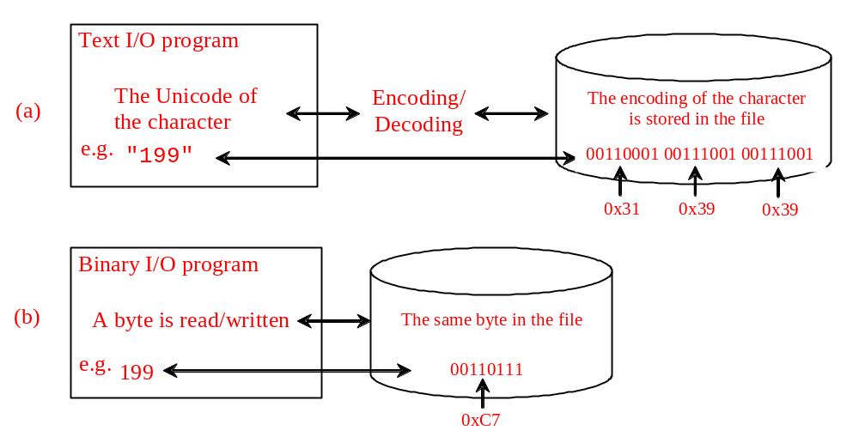
Binary I/O
Text I/O requires encoding and decoding.
  The JVM converts a Unicode to a file specific encoding when writing a character and coverts a file specific encoding to a Unicode when reading a character.
Binary I/O does not require conversions.
  When you write a byte to a file, the original byte is copied into the file. When you read a byte from a file, the exact byte in the file is returned.

Slide 43
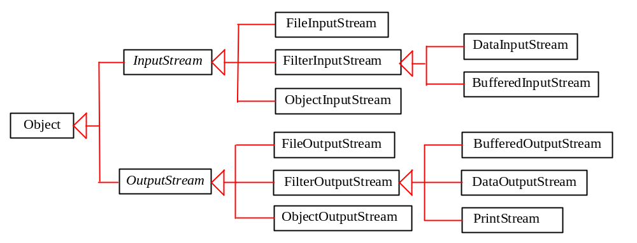
Binary I/O Classes

Slide 44
Reading binary data from files
FileInputStream: a class in the java.io package that lets you read binary data in chunks whose size you specify.
Setting up an input file, general syntax:
  FileInputStream <name> =
  new FileInputStream(new File("<file name>"));
Example:
  FileInputStream input = new FileInputStream(new File(“input.mp3"));
  int nextByte = input.read();
  byte [] buffer = new byte[100];
  int numBytesRead = input.read(buffer);

Slide 45
Outputting binary data to files
PrintStream: Another class in the java.io package that lets you print output to a destination such as a file.
Writer: text output, Stream: binary output
System.out is a PrintStream object!
  Any methods you have used on System.out (such as print, println) will work on every PrintStream object.

Slide 46
Setting up the PrintStream
Setting up an output file, general syntax:
  PrintStream <name> =
  new PrintStream(new File("<file name>"));
Example:
  PrintStream output = new PrintStream(new File("output.txt"));
  output.println("Hello, file!");
  output.println("This is a second line of output.");
  Or
  output.write(buffer, offset, numBytes);

Slide 47
PrintStream warning
Caution: Do not open a file for reading (Scanner) and writing (PrintStream) at the same time.
  You could overwrite your input file by accident!

Slide 48
Exercise
Write a class named BinaryCopier that reads in two filenames from the user and copies the binary contents from the first file into the second file.

Slide 49
Solution
public class BinaryCopier {
public static void main(String [] args)‏
throws FileNotFoundException, IOException
{
Scanner kb = new Scanner(System.in);
String name1 = kb.next();
String name2 = kb.next();
FileInputStream input =
new FileInputStream(new File(name1));
PrintStream output =
new PrintStream(new File(name2));
byte [] buffer = new byte[100];
int numBytesRead = input.read(buffer);
while (numBytesRead > -1) {
output.write(buffer, 0, numBytesRead);
}
input.close();
output.close();
}
}

Slide 50
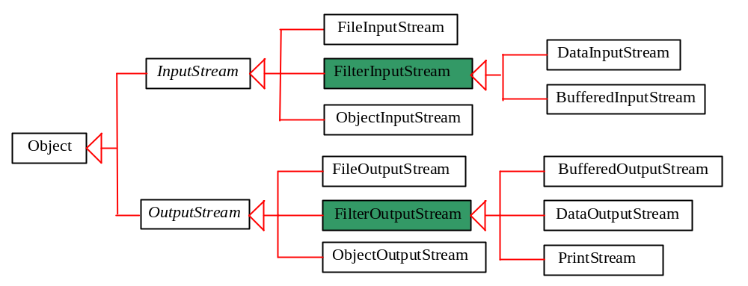
FilterInputStream/FilterOutputStream
Filter streams are streams that filter bytes for some purpose.
  The basic byte input stream provides a read method that can only be used for reading bytes.
  If you want to read integers, doubles, or strings, you need a filter class to wrap the byte input stream. Using a filter class enables you to read integers, doubles, and strings instead of bytes and characters.
  FilterInputStream and FilterOutputStream are the base classes for filtering data. When you need to process primitive numeric types, use DatInputStream and DataOutputStream to filter bytes.

Slide 51
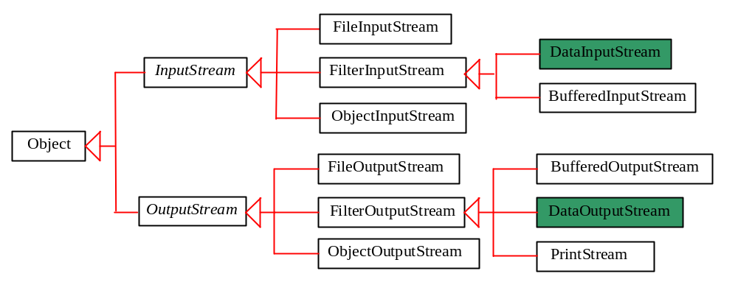
DataInputStream/DataOutputStream
DataInputStream reads bytes from the stream and converts them into appropriate primitive type values or strings.
DataOutputStream converts primitive type values or strings into bytes and output the bytes to the stream.

Slide 52
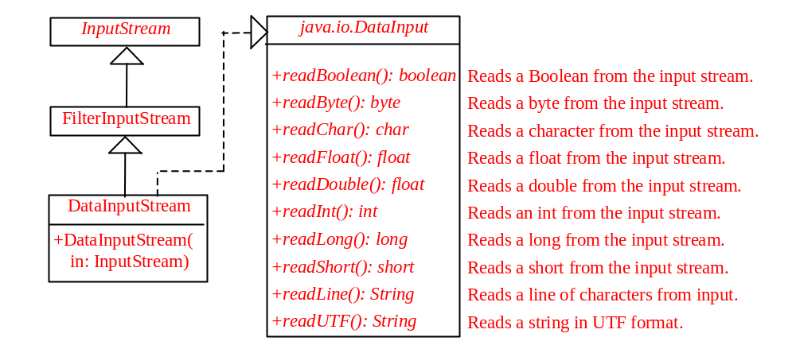
DataInputStream
DataInputStream extends FilterInputStream and implements the DataInput interface.

Slide 53
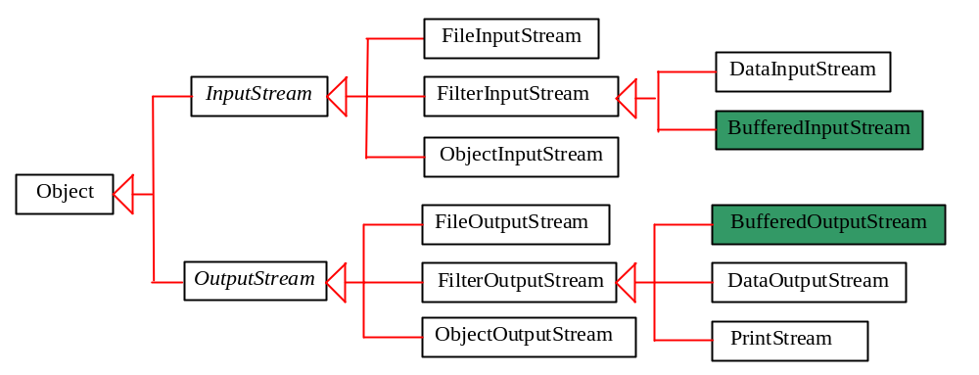
BufferedInputStream/BufferedOutputStream
Using buffers to speed up I/O
  BufferedInputStream/BufferedOutputStream does not contain new methods.
  All the methods BufferedInputStream/BufferedOutputStream are inherited from the InputStream/OutputStream classes.

Slide 54
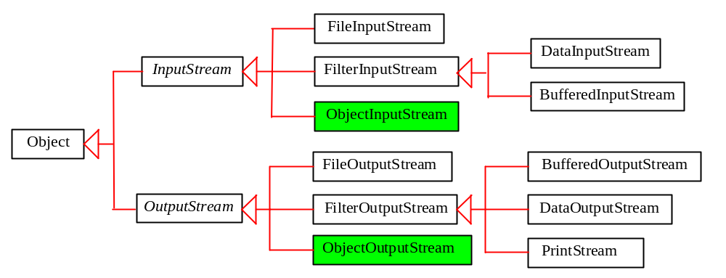
Object I/O
DataInputStream/DataOutputStream enables you to perform I/O for primitive type values and strings.
ObjectInputStream/ObjectOutputStream enables you to perform I/O for objects in addition for primitive type values and strings.

Slide 55
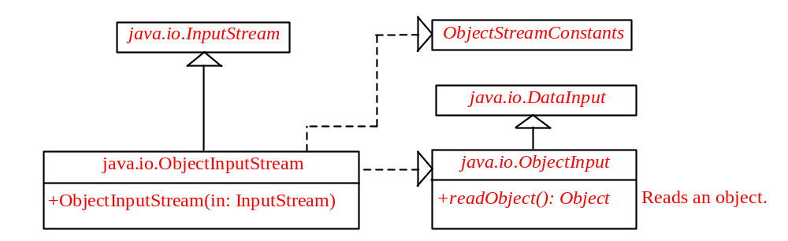
ObjectInputStream
ObjectInputStream extends InputStream and implements ObjectInput and ObjectStreamConstants.

Slide 56
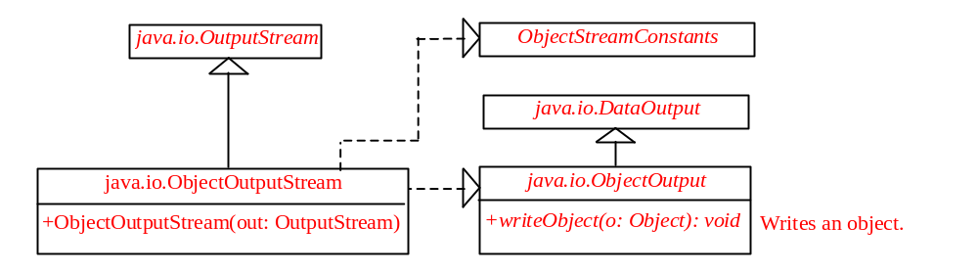
ObjectOutputStream
ObjectOutputStream extends OutputStream and implements ObjectOutput and ObjectStreamConstants.

Slide 57
The Serializable Interface
Not all objects can be written to an output stream.
  Objects that can be written to an object stream is said to be serializable. A serializable object is an instance of the java.io.Serializable interface. So the class of a serializable object must implement Serializable.
The Serializable interface is a marker interface.
  It has no methods, so you don't need to add additional code in your class that implements Serializable.
Implementing this interface enables the Java serialization mechanism to automate the process of storing the objects and arrays.

Slide 58
The transient Keyword
If an object is an instance of Serializable, but it contains non-serializable instance data fields, can the object be serialized?
  The answer is no.
To enable the object to be serialized, you can use the transient keyword to mark these data fields to tell the JVM to ignore these fields when writing the object to an object stream.

Slide 59
The transient Keyword, cont.
Consider the following class:
public class Foo implements java.io.Serializable {
private int v1;
private static double v2;
private transient A v3 = new A();
}
class A { } // A is not serializable
When an object of the Foo class is serialized, only variable v1 is serialized. Variable v2 is not serialized because it is a static variable, and variable v3 is not serialized because it is marked transient. If v3 were not marked transient, a java.io.NotSerializableException would occur.

Slide 60
Random Access Files
All of the streams you have used so far are known as read-only or write-only streams.
The external files of these streams are sequential files that cannot be updated without creating a new file.
It is often necessary to modify files or to insert new records into files. Java provides the RandomAccessFile class to allow a file to be read from and write to at random locations.

Slide 61
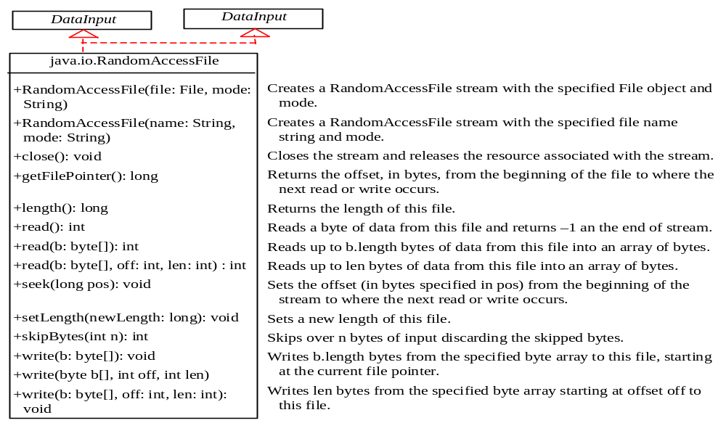
RandomAccessFile

Slide 62
RandomAccessFile Methods
Many methods in RandomAccessFile are the same as those in DataInputStream and DataOutputStream.
  For example, readInt(), readLong(), writeDouble(), readLine(), writeInt(), and writeLong() can be used in data input stream or data output stream as well as in RandomAccessFile streams.

Slide 63
RandomAccessFile Methods, cont.
void seek(long pos) throws IOException;
Sets the offset from the beginning of the RandomAccessFile stream to where the next read
or write occurs.
long getFilePointer() IOException;
Returns the current offset, in bytes, from the
beginning of the file to where the next read
or write occurs.

Slide 64
RandomAccessFile Methods, cont.
long length()IOException
Returns the length of the file.
final void writeChar(int v) throws IOException
Writes a character to the file as a two-byte Unicode, with the high byte written first.
final void writeChars(String s)
throws IOException
Writes a string to the file as a sequence of
characters.

